Slide 1
Low Fidelity Design
Team Pinpoint Andy Hoang, Citlally Vasquez, Darrel Dennis, Max Ju, Troy Waters, Wai Soltow

Slide 2

Recap
Recap:
Localized social media app that allows users to post Pins.
Pins:
Post containing text and an image. Could be for an event, could be discussion. Freedom to interact with other local users.

Slide 3

Key User Insight:
No Intuitive Tools for Event Discovery:
Our Map feature justified as the most seamless way for people to view posts in a local area.

Slide 4
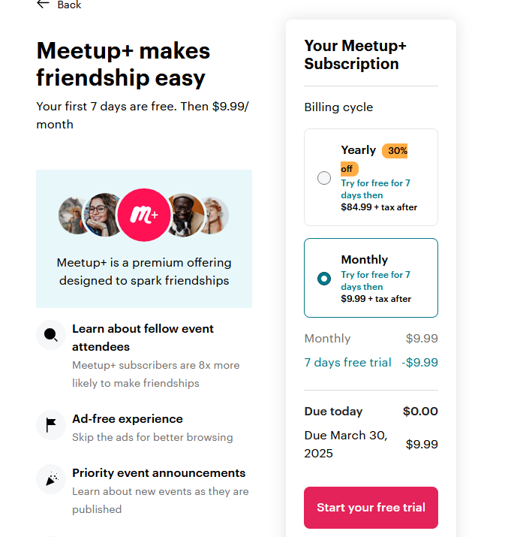
Market Research Insight
Meetup:
Unpleasant onboarding experience. Allow users free registration first
Nextdoor:
Only for neighborhoods. Expand focus past strict neighborhoods
Notes:
(DARREL: My bad Max XP) A while true, I think what is meant by key insight is weaknesses/gaps from our competition or repeated ideas from interviews.

Slide 5
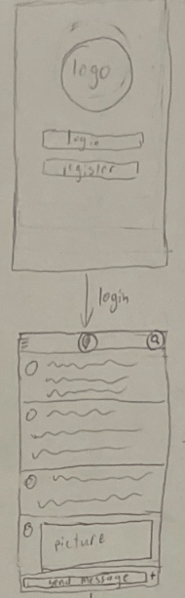
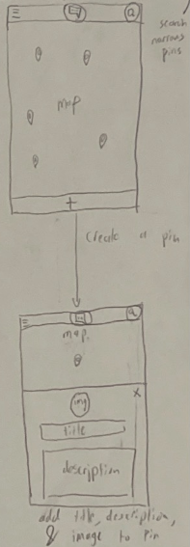
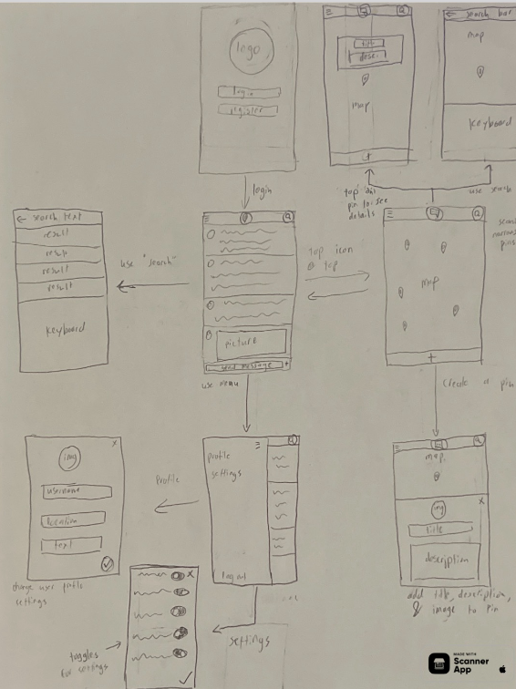
Wireframe 1 Overview
Key Ideas:
- Nice, seamless transitions between screens
- Mode selector and indicator at the top of the screen
- Search feature
Notes:
Maybe talk about how we decided to use this wireframe as our basis for navigation flow

Slide 6
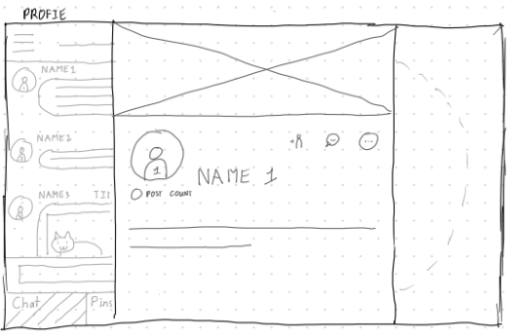
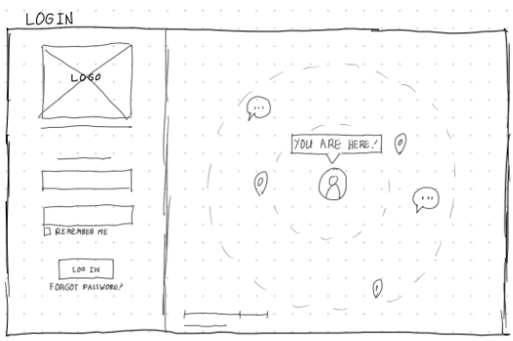
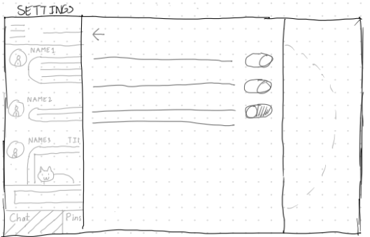
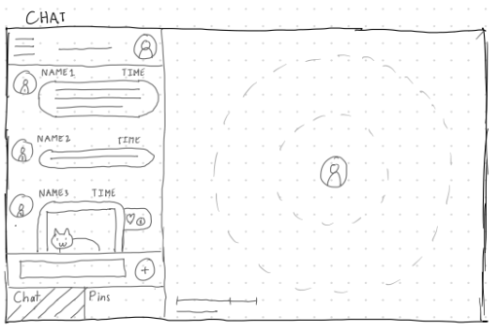
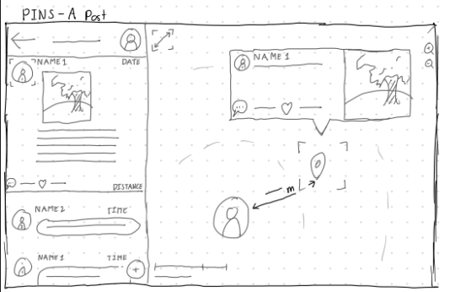
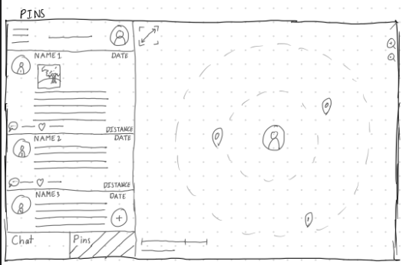
Wireframe 2
Feeling Present: This wireframe of ours was created to emphasise the feeling of proximity w/ distance and interaction radius indicators
Showing the same content in different ways:
When viewing a post, this wireframe would both update the map and the text-based feed on the left.
Exploring a desktop/tablet experience:
We’ve decided on a mobile experience first, but this wireframe was drawn to see how a desktop/tablet view might work.
Notes:
Feeling present:
Distance indicators on post
A line is drawn on the map between the user and the pin
A radii circle implying a radar

Slide 7
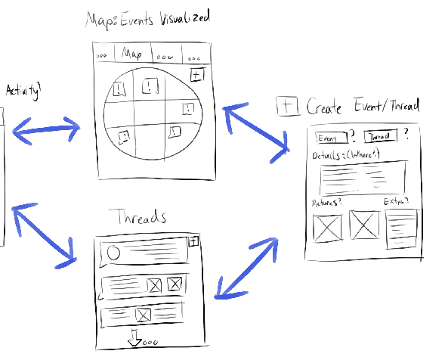
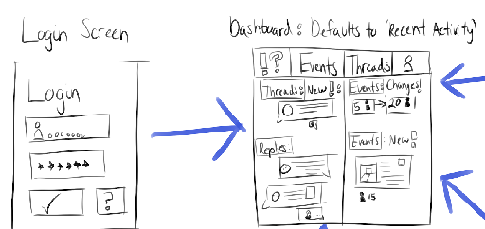
Wireframe 3 Overview
Updates and Notifications:
- Consolidating every tab into one for easy navigation - Micromanagement. Users can stay up to date without checking every individual page
Troy Waters

Slide 8
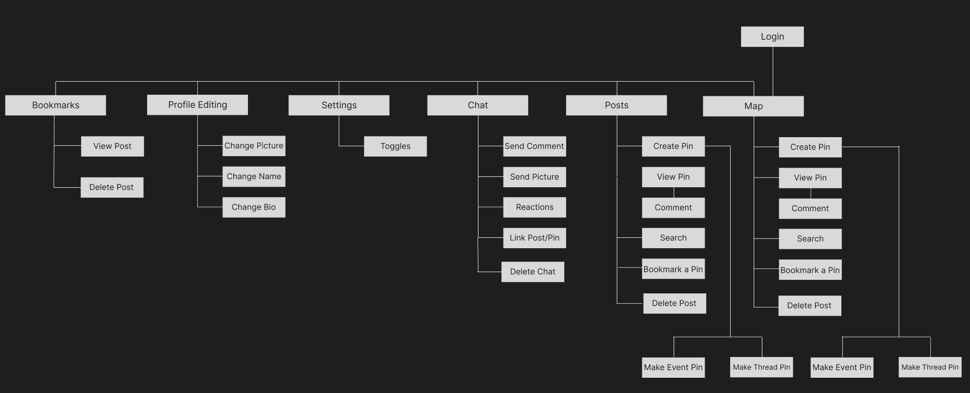
Digital Information Architecture

Slide 9

Feature Selection: Bookmarks
For users to keep track of pins
Only for users to see
Based on user feedback
Competitors have similar feature

Slide 10
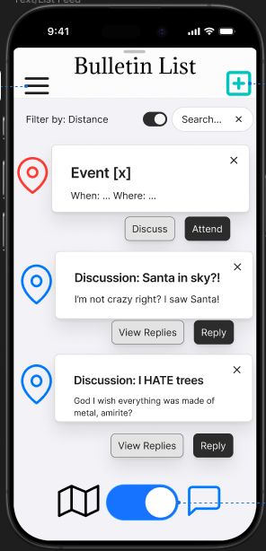
https://www.figma.com/proto/12HzxaGMVS5jYRPJCqxUbh/Milestone-4?node-id=233-715&t=hyNr3XVJUm1J9TyL-1

Slide 11


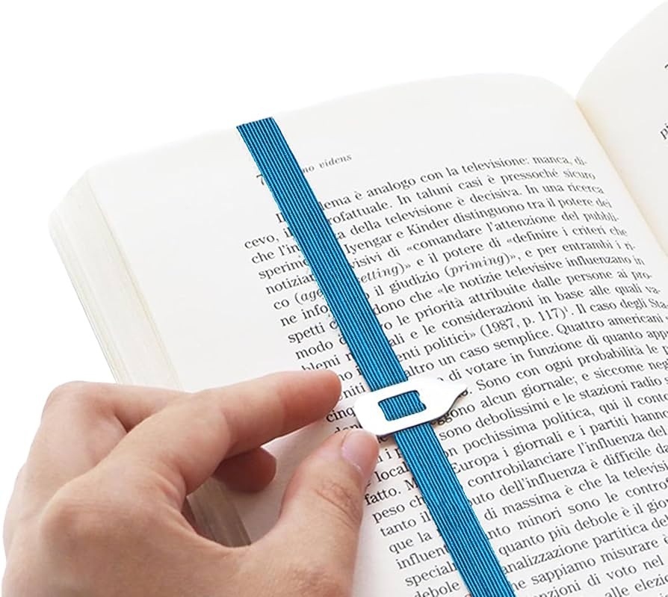
TODO: The To-dos
(Always) room for improvement:
Friends:
Sharing & private chats
Bookmarks:
interacting outside proximity, engage more directly with interest
Settings:
to accommodate to users desires and new features
Troy Waters

Slide 12
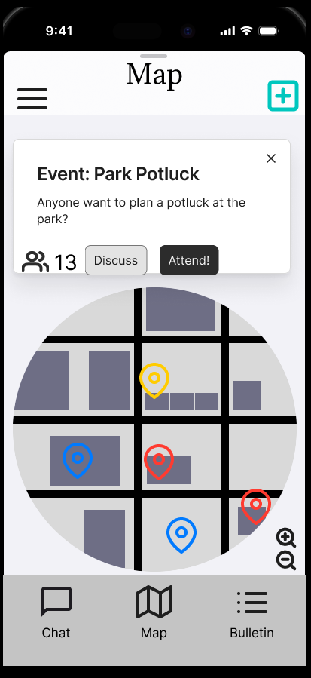
Summary:
Mobile focused design
3 main pages
Pin Distance Cap
Event and Discussion pins

Slide 13
Thanks for listening! Any questions?

Slide 14
NOTES: Key decisions made
Mobile only
Screen Hierarchy: Option 2
Map Screen: Option 3 (W/ Option 1’s pin creation features) (Map w/ a list you can pull up)
Text Based Feed: Option 3
Profile Screen: Option 3
Setting Screen: Option 1 + 3 Mix
Update tab
Bookmark tab
Enforce accounts
Default Screen: Map
3 Pages
Pin Distance Cap:
Profile Customization
Interest Count

